Slide 1
CS 4530
Fundamentals of Software Engineering
Module 16A: Engineering Ethical Software
Adeel Bhutta, Joydeep Mitra and Mitch Wand
Khoury College of Computer Sciences
© 2025 Released under the CC BY-SA license

Slide 2
Learning Goals
By the end of this lesson, you should be able to…
Illustrate how software can cause inadvertent harm or amplify inequities
Explain the role of human values in designing software systems
Explain some techniques that software engineers can use in producing software systems that are more congruent with human values.

Slide 3
Ethically and morally problematic technology is everywhere!
Algorithms that gate access to loans, insurance, employment, government services…
Algorithms that perpetuate or exacerbate existing discrimination
Bad medical software can kill people (Therac-25)
UIs that discriminate against differently-abled people
Third-party data collection for hyper-targeted advertising
LLM's that harvest copyright or personal data
And on… and on… and on…
Notes:
<Read Slide, with ad lib details as you wish>

Slide 4
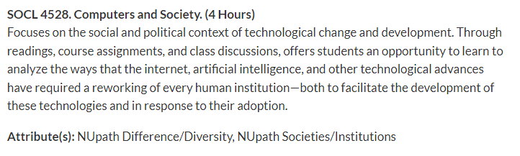
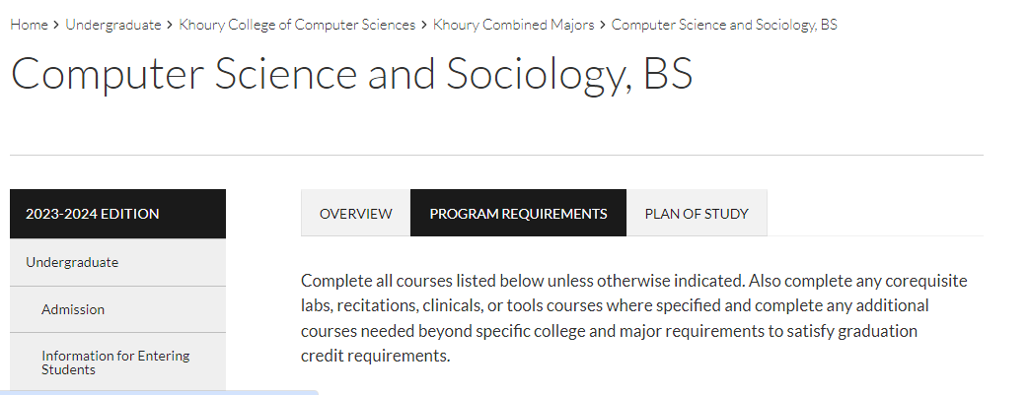
And this is only the tip of the iceberg
Other Challenges:
interfaces and systems designed to be addictive;
corporate ownership of personal data;
weak cyber security and personally identifiable information (PII) protection;
and many more …
Notes:
The more we understand the different ways in which our software affects individuals and society at large, the better we can become at avoiding or mitigating such negative effects.
Why, you could teach a whole course about it!
<click>
Or even a whole program
<click>

Slide 5
Equity and Software
As new as software engineering is, we’re newer still at understanding its impact on underrepresented people and diverse societies.
We must recognize imbalance of power between those who make development decisions that impact the world.
and those who simply must accept and live with those decisions that sometimes disadvantage already marginalized communities globally.
Quote: “Software Engineering at Google: Lessons Learned from Programming Over Time,” Wright et al, 2020 (O’Reilly)
Notes:
There is an enormous imbalance of power between those of us who make software development decisions, building software that’s used broadly, and the rest of the world that simply must accept and live with those decisions. As software engineers, you will likely wield more power than you realize.

Slide 6
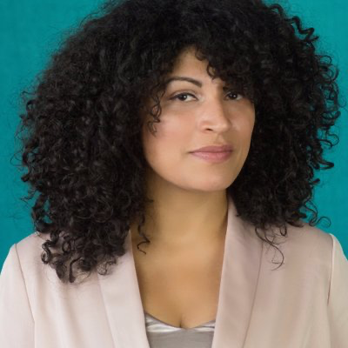
Recognize inequities in your software
One mark of an exceptional engineer is the ability to understand how products can advantage and disadvantage different groups of human beings
Engineers are expected to have technical aptitude, but they should also have the discernment to know when to build something and when not to
Demma Rodriguez Head of Equity Engineering, Google 2018-2020
Meta 2020-2022
AirBnB 2022-present
Quote: “Software Engineering at Google: Lessons Learned from Programming Over Time,” Wright et al, 2020 (O’Reilly)
Notes:
Being an exceptional engineer means not only that you know HOW to build some great features, but that you have the judgement to be able to identify and reject features or products that drive adverse outcomes.

Slide 7
More than don’t be evil
Engineering equitable software requires conscious effort
How do we weigh competing interests and values?
How do we determine what “the right thing” is?
How do we convince our investors/managers to take this action?
Notes:
Engineering equitable software requires conscious effort. It is not simple enough to take on a motto like “don’t be evil” or “do the right thing,” when it is often difficult to fully comprehend the societal impacts of our technical decisions. Any piece of software, or any feature can have both good and bad impacts. Moreover, even when we do see a clear potential harm to some portion of the population, taking corrective action can be challenging.

Slide 8
Identify Unintended Consequences
Technology will be adopted in unanticipated ways. Being intellectually rigorous means considering and mitigating risks in designs ahead of time.
What if:
Our recommendation system promotes misinformation or hate speech?
Our database is breached and publicly released?
Our facial recognition AI is used to identify and harass peaceful protestors?
Our child safety app is used to stalk women?
Our chatbot is sexist or racist?
Notes:
Hard to not do evil when you’re building powerful tools. <read slide>

Slide 9
Identify the human and social contexts in which our software will run
Social Context
Business Context
Legal and Regulatory Context
Others?

Slide 10
What is the social context?
what categories of people will benefit from our software?
what categories of people will be harmed by the use of our software?

Slide 11
What is the business context?
Who is going to pay for this software?
users?
advertisers?
sponsors or sponsoring agencies?
What are their incentives?
how do their incentives affect (or distort) our priorities in designing or developing this software?
if our sponsors are selling advertising, then we may be pressed to prioritize "engagement" (maybe undesirable)
if our sponsors want to help disadvantaged people to connect with services, we may be pressed to prioritize accessibility.

Slide 12
Who is selling what to who?
"If you're not paying for the product, then you are the product"
--
Generally credited to Richard Serra and Carlota Fay Schoolman (1974, about TV advertising)

Slide 13
What is the legal and regulatory context?
Americans with Disabilities Act (ADA)
Litigation-averse sponsors may insist on elaborate Terms & Conditions
Software for use in the EU may need to comply with the GPDR.
What about financial software?
What about personal data?
What about leaving cookies, etc., on our machines?

Slide 14
Is the activity of the software transparent?
What data does it collect about the individual user?
Does it store things on our computers?
Does it touch our files?
Does it violate the "CIA" of computer security?

Slide 15
Special considerations for AI
Incentives for AI system may be particularly mysterious
What objective function is your LLM optimizing?
AI "agents" that operate in the real world present particularly complicated risks

Slide 16
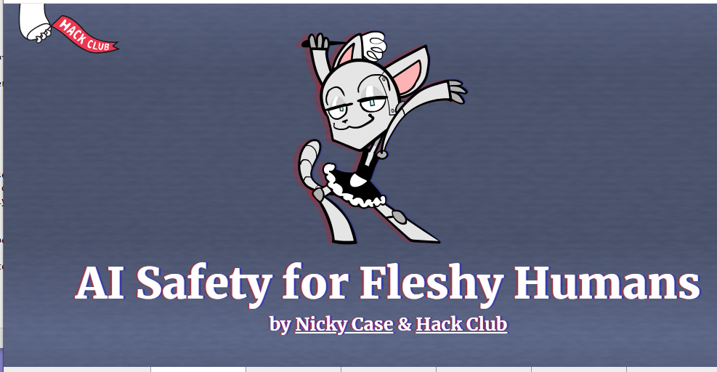
A short course in AI safety
aisafety.dance

Slide 17
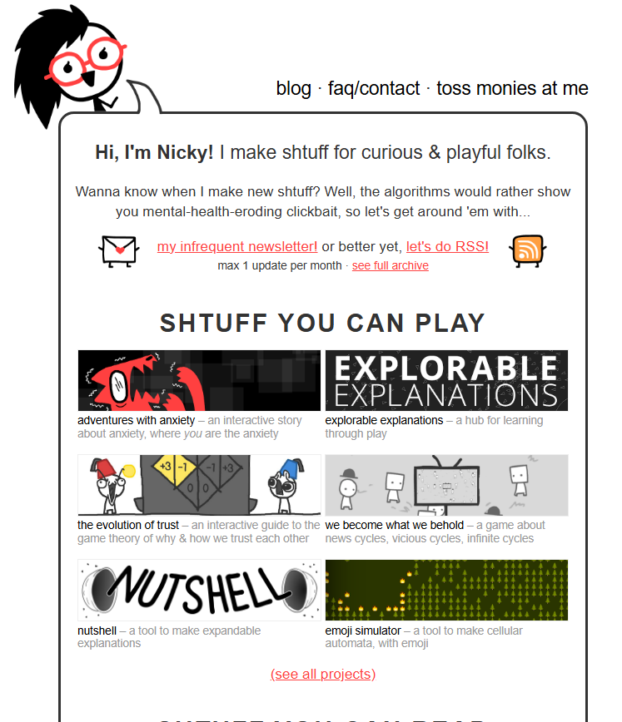
A short plug for Nicky Case
ncase.me

Slide 18
What can we do?
There is not a single standard that everyone follows for developing ethical or equitable software.
There have been a number of attempts:
Value Sensitive Design
Microsoft's Responsible AI Standard
Gender Inclusive Design
and many more
Notes:
<read slide>

Slide 19
Value Sensitive Design: an approach to consider human values in the design process.
Technology is the result of human imagination
All technology involves design
All design involves choices among possible options
All choices reflects values
Therefore, all technologies reflect and affect human values
Ignoring values in the design process is irresponsible
Identify Direct and Indirect Stakeholders
Identify Human Values
Study Impact of Values on Stakeholders
Resolve Value Tensions and Identify unintended consequences
https://vsd.ccs.neu.edu/introduction/what-is-vsd/
Notes:
Ethics here is not about not doing terrible things. The assumption is that you are not evil.
The problem is how to be successful at doing good things (e.g. preventing election manipulation, improving education outcomes), as well as avoiding doing things that appear fine but turn out to be problematic (e.g. that violate privacy or exacerbate injustices)

Slide 20

Microsoft’s Trust Code includes a standards that is based on 6 values
Microsoft’s company-wide "Trust Code," covers specific policies like the: Responsible AI Standard, and codes of conduct for open-source communities
The Responsible AI Standard focuses on fairness, privacy, reliability, inclusiveness, transparency, and accountability for AI systems.
https://www.microsoft.com/en-us/legal/compliance/sbc
Notes:
Ethics here is not about not doing terrible things. The assumption is that you are not evil.
The problem is how to be successful at doing good things (e.g. preventing election manipulation, improving education outcomes), as well as avoiding doing things that appear fine but turn out to be problematic (e.g. that violate privacy or exacerbate injustices)

Slide 21
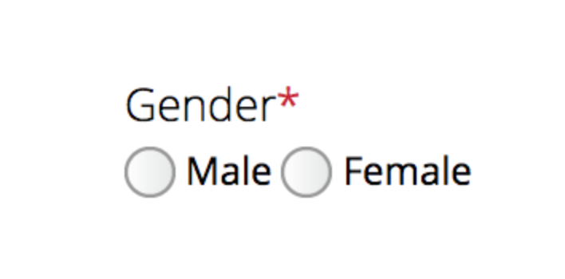
Gender Inclusive Design
Gender Stereotypes are fairly common in real world and many apps
GenderMag is a structured approach for evaluating – and fixing – technology products and services
A set of cognitive styles for using technology that statistically cluster by gender. ​These are the 5 facets.
A set of a fictional people (called personas)
Evaluation walkthrough: a prescribed series of steps to uncover gender-inclusion issues
https://gendermag.org/
Notes:
<read slide>

Slide 22




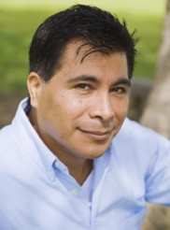


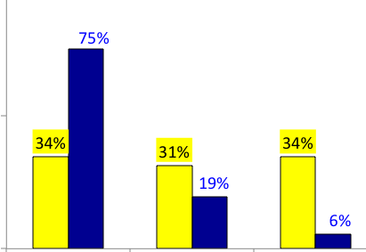
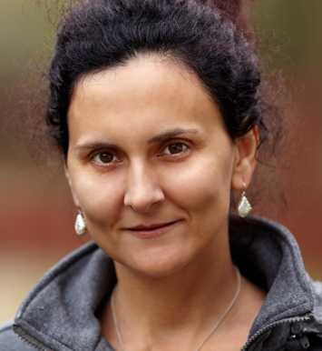



GenderMag
Facets
Information processing style
Learning style for new technology
Computer self-efficacy
Attitude to risk
Motivations
Personas
Abi, Tim and Pat
Walkthrough
Answer a series of questions for each persona
Generate Report on usage differs
Tim
Pat
Abi
High
Medium
Low
Notes:
<read slide> Example: Can each gender ask the question on stack overflow. Follow a series of steps to see how each gender will use the site and identify differences.

Slide 23
Don’t ignore the challenges
Have a core set of Principles of Ethical SE/AI
Harvard: Fairness, Transparency, Accountability, Privacy, Security
AWS: Fairness, Explainability, Privacy and security, Safety, Controllability, Veracity and robustness
Google AI: Design for safety, Be transparent, Secure AI systems
Follow guidelines like - Balance technical and moral responsibility
Be Proactive
Be honest
Be accountable
Be a responsible citizen
Notes:
There’s no silver bullet for ethical software development. However, hopefully now you understand better the different ways that our software can have impacts on others, and how we can reason about those implications. We have talked about understanding users’ needs better which can be helpful in making better decisions

Slide 24
There are SE-level mitigations for some of these risks
Form a diverse team
People from diverse backgrounds bring different experiences and different perspectives
Consider human values throughout the project
Rely on standards when possible
ADA
ARIA
etc.
Monitor actual usage & misusage, user feedback
who? what? when? how?

Slide 25
Systemic mitigations
Work for systemic change?
political, social, etc.
Work to convince developers to consider human values?

Slide 26
Where does this leave us?
So that we can sleep at night
Consider the different ways that our software may impact others
Consider the ways in which our software interacts with the political, social, and economic systems in which we and our users live
Follow best practices, and actively push to improve them
Encourage diversity in our development teams
Engage in honest conversations with our co-workers and supervisors to explore possible ethical issues and their implications.
Notes:
There’s no silver bullet for ethical software development. However, hopefully now you understand better the different ways that our software can have impacts on others, and how we can reason about those implications. We have talked about understanding users’ needs better which can be helpful in making better decisions

